Slide 1
Methods

Slide 2
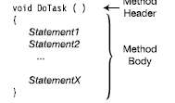
The Structure of a Method
Essentially, a method is a block of code with a name. You can execute the code by using the method’s name. You can pass data into a method and receive data as output.
As we mentioned earlier, a method is a function member of a class. Methods have two major sections, as shown in Figure the method header and the method body.
• The method header specifies the method’s characteristics, including the following:
– Whether the method returns data, and if so, what type
– The name of the method
– What types of input can be passed to the method
• The method body contains the sequence of executable code statements. Execution starts at the first statement in the method body and continues sequentially through the method.

Slide 3
The following example shows the form of the method header. I will cover each part in the following pages.
int MyMethod ( int intpar1, string strpar1 )
↑ ↑ ↑
Return type Method Parameter name list
Methods can also be function members of another user-defined type called a struct, which we talk about it later . Most of what this chapter covers about class methods will also be true for struct methods.
For example, the following code shows a simple method called MyMethod, that, in turn, calls the WriteLine method several times:
void MyMethod()
{
Console.WriteLine("First");
Console.WriteLine("Last");
}

Slide 4
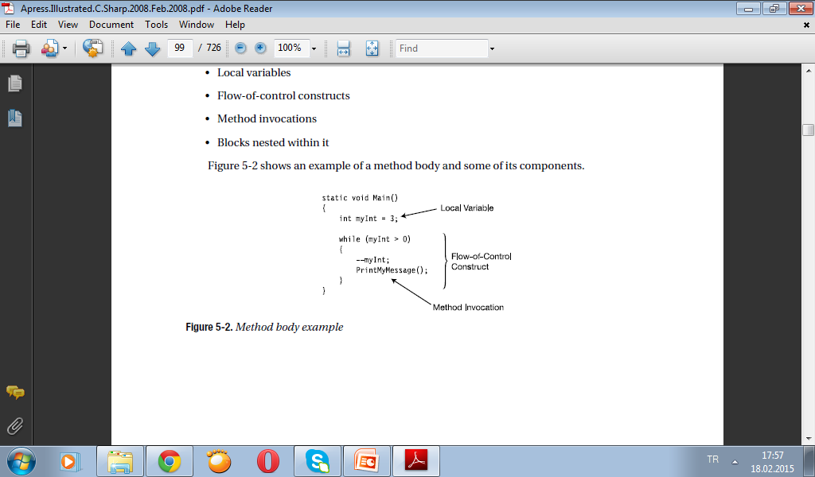
Code Execution in the Method Body
The method body is a block, which is a sequence of statements
between curly braces. A block can contain the following items:
• Local variables
• Flow-of-control constructs
• Method invocations
• Blocks nested within it
Figure shows an example of a method body and some of its components.

Slide 5
Local Variables
Like fields, local variables store data. While fields usually store data about the state of the object, local variables are usually created to store data for local, or transitory, computations.
The following line of code shows the syntax of local variable declarations. The optional initializer consists of the equals sign followed by a value to be used to initialize the variable.
Variable name
↓
Type Identifier = Value;
↑
Optional initializer
• The existence of a local variable is limited to the block in which it is created and the blocks nested within it.
– It comes into existence at the point at which it is declared.
– It goes out of existence when the block completes execution.
• You can declare local variables at any position in the method body.

Slide 6
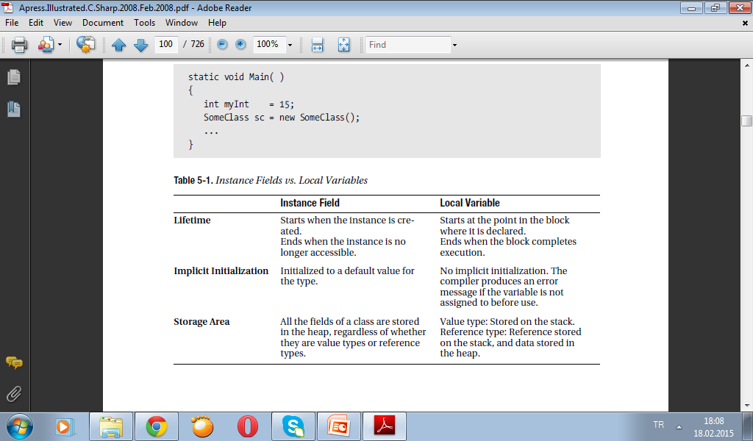
The following example shows the declaration and use of two local variables. The first is of type int, and the second is of type SomeClass.
static void Main( )
{
int myInt = 15;
SomeClass sc = new SomeClass();
...
}
Table compares and contrasts local variables and instance fields.

Slide 7
Type Inference and the var Keyword
If you look at the following code, you will see that when you supply the type name at the beginning of the declaration, you are supplying information that the compiler should already be able to infer from the right-hand side of the initialization.
• In the first variable declaration, the compiler can infer that 15 is an int.
• In the second declaration, the object-creation expression on the right-hand side returns
an object of type MyExcellentClass.
So in both cases, including the explicit type name at the beginning of the declaration is
redundant.
static void Main( )
{
int total = 15;
MyExcellentClass mec = new MyExcellentClass();
...
}
Starting with C# 3.0 you can now use the new keyword var in place of the explicit type name at the beginning of the variable declaration, as follows:

Slide 8
static void Main( )
{ Keyword
↓
var total = 15;
var mec = new MyExcellentClass();
...
}
The var keyword does not signal a special kind of variable. It is just syntactic shorthand for whatever type can be inferred from the initialization on the right-hand side. In the first declaration, it is shorthand for int. In the second, it is shorthand for MyExcellentClass. The preceding code segment with the explicit type names and the code segment with the var keywords are semantically equivalent.
Some important conditions on using the var keyword are the following:
• It can only be used with local variables—not with fields.
• It can only be used when the variable declaration includes an initialization.
• Once the compiler infers the type, it is fixed and unchangeable.

Slide 9
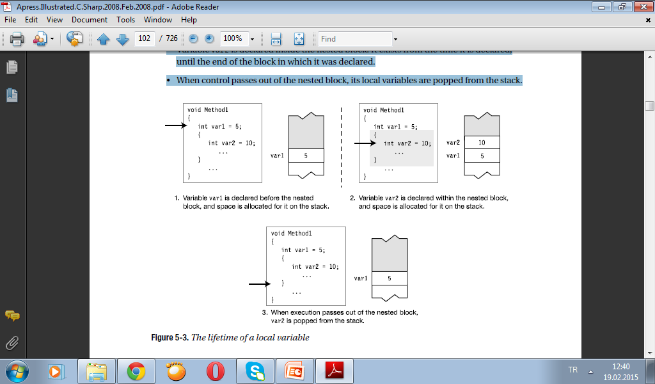
Local Variables Inside Nested Blocks
Method bodies can have other blocks nested inside them.
• There can be any number of blocks, and they can be sequential or nested further. Blocks
can be nested to any level.
• Local variables can be declared inside nested blocks, and like all local variables, their
lifetime is limited to the block in which they are declared and the blocks nested within it.
Figure illustrates the lifetimes of two local variables, showing the code and the state of
the stack. The arrows indicate the line that has just been executed.
• Variable var1 is declared in the body of the method, before the nested block.
• Variable var2 is declared inside the nested block. It exists from the time it is declared,
until the end of the block in which it was declared.
• When control passes out of the nested block, its local variables are popped from the stack.

Slide 10
Local Constants
A local constant is much like a local variable, except that once it’s initialized, its value can’t be changed. Like a local variable, a local constant must be declared inside a block.
The two most important characteristics of a constant are the following:
• A constant must be initialized at its declaration.
• A constant cannot be changed after its declaration.
The core declaration for a constant is shown following. The syntax is the same as that of a field or variable declaration, except for the following:
• The addition of the keyword const before the type.
• The mandatory initializer. The initializer value must be determinable at compile time,
and is usually one of the predefined simple types or an expression made up of them. It
can also be the null reference, but it cannot be a reference to an object, because references to objects are determined at run time.
Keyword
↓
const Type Identifier = Value;
↑
Initializer required

Slide 11
A local constant, like a local variable, is declared in a method body or code block, and goes out of scope at the end of the block in which it is declared.
void DisplayRadii()
{
const double PI = 3.1416; // Declare local constant
for (int radius = 1; radius <= 5; radius++)
{
double area = radius * radius * PI; // Read from local constant
Console.WriteLine("Radius: {0}, Area: {1}", radius, area);
}
}

Slide 12
Flow of Control
Methods contain most of the code for the actions that comprise a program. The remainder is in other function members, such as properties and operators—but the bulk is in methods.
• Selection statements: These statements allow you to select which statement, or block of statements, to execute.
– if: Conditional execution of a statement
– if...else: Conditional execution of one statement or another
– switch: Conditional execution of one statement from a set
• Iteration statements: These statements allow you to loop, or iterate, on a block of
statements.
– for: Loop—testing at the top
– while: Loop—testing at the top
– do: Loop—testing at the bottom
– foreach: Execute once for each member of a set
• Jump statements: These statements allow you to jump from one place in the block or
method to another.
– break: Exit the current loop.
– continue: Go to the bottom of the current loop.
– goto: Go to a named statement.
– return: Return execution to the calling method.

Slide 13
void SomeMethod()
{
int intVal = 3;
Equality comparison operator
↓
if( intVal == 3 ) // if statement
Console.WriteLine("Value is 3.");
for( int i=0; i<5; i++ ) // for statement
Console.WriteLine("Value of i: {0}", i);
}

Slide 14
Method Invocations
You can call other methods from inside a method body.
• The phrases call a method and invoke a method are synonymous.
• You call a method by using its name, along with the parameter list, which I will discuss
shortly.
class MyClass
{
void PrintDateAndTime( ) // Declare the method.
{
DateTime dt = DateTime.Now; // Get the current date and time.
Console.WriteLine("{0}", dt); // Write it out.
}
static void Main() // Declare the method.
{
MyClass mc = new MyClass();
mc.PrintDateAndTime ( ); // Invoke the method.
} ↑ ↑
} Method name Empty parameter list

Slide 15
Return Values
A method can return a value to the calling code. The returned value is inserted into the calling code at the position in the expression where the invocation occurred.
• To return a value, the method must declare a return type before the method name.
• If a method does not return a value, it must declare a return type of void.
Return type
↓
int GetHour() { ... }
void DisplayHour() { ... }
↑
No value is returned.
Return type
↓
int GetHour( )
{
DateTime dt = DateTime.Now; // Get the current date and time.
int hour = dt.Hour; // Get the hour.
return hour; // Return an int.
} ↑
Return statement

Slide 16
You can also return objects of user-defined types. For example, the following code returns an object of type MyClass.
Return type -- MyClass
↓
MyClass method3( )
{
MyClass mc = new MyClass();
...
return mc; // Return a MyClass object.
}

Slide 17
class MyClass
{ ↓ Return type
public int GetHour()
{
DateTime dt = DateTime.Now; // Get the current date and time.
int hour = dt.Hour; // Get the hour.
return hour; // Return an int.
} ↑
} Return value
class Program
{
static void Main()
{ Method invocation
MyClass mc = new MyClass(); ↓
Console.WriteLine("Hour: {0}", mc.GetHour());
} ↑ ↑
} Instance name Method name

Slide 18
The Return Statement and Void Methods
You can exit from a method at any time by using the following form of the return statement, with no parameters:
return;
Void return type
↓
void SomeMethod()
{
...
If ( SomeCondition ) // If ...
return; // return to the calling code.
...
If ( OtherCondition ) // If ...
return; // return to the calling code.
...
}

Slide 19
class MyClass
{ ↓ Void return type
void TimeUpdate()
{
DateTime dt = DateTime.Now; // Get the current date and time.
if (dt.Hour < 12) // If the hour is less than 12,
return; // then return.
↑
Return to calling method.
Console.WriteLine("It's afternoon!"); // Otherwise, print message.
}
static void Main()
{
MyClass mc = new MyClass(); // Create an instance of the class.
mc.TimeUpdate(); // Invoke the method.
}
}

Slide 20
Parameters
Formal parameters are local variables that are declared in the method’s parameter list, rather than in the body of the method.
public void PrintSum( int x, float y )
{ ... } ↑
Formal parameter declarations
public void PrintSum( int x, int y )
{
int Sum = x + y;
Console.WriteLine("Newsflash: {0} + {1} is {2}", x, y, Sum);
}

Slide 21
class MyClass Formal parameters
{ ↓
public int Sum(int x, int y) // Declare the method.
{
return x + y; // Return the sum.
} Formal parameters
↓
public float Avg(float Input1, float Input2) // Declare the method.
{
return (Input1 + Input2) / 2.0F; // Return the average.
}
}
class Class1
{
static void Main()
{
MyClass MyT = new MyClass();
int SomeInt = 6;
Console.WriteLine("Newsflash: Sum: {0} and {1} is {2}",
5, SomeInt, MyT.Sum( 5, SomeInt )); // Invoke the method.
↑
Actual parameters
Console.WriteLine ("Newsflash: Avg: {0} and {1} is {2}",
5, SomeInt, MyT.Avg( 5, SomeInt )); // Invoke the method.
} ↑
} Actual parameters
Newsflash: Sum: 5 and 6 is 11
Newsflash: Avg: 5 and 6 is 5.5

Slide 22
class MyClass
{ public int Val = 20; } // Initialize the field to 20.
class Program Formal parameters
{ ↓
static void MyMethod( MyClass f1, int f2 )
{
f1.Val = f1.Val + 5; // Add 5 to field of f1 param.
f2 = f2 + 5; // Add 5 to second param.
}
static void Main( )
{
MyClass A1 = new MyClass();
int A2 = 10;
MyMethod( A1, A2 ); // Call the method.
} ↑
} Actual parameters

Slide 23
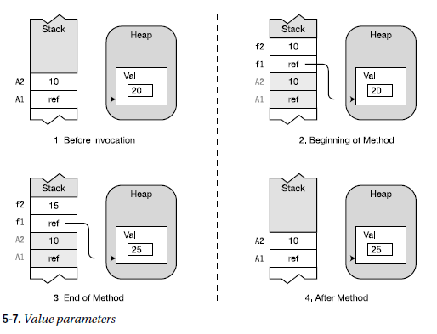

Slide 24
Parameter Arrays
In the parameter types I’ve covered so far, there must be exactly one actual parameter for each formal parameter. Parameter arrays are different in that they allow zero or more actual parameters for a particular formal parameter. Important points about parameter arrays are the following:
• There can be only one parameter array in a parameter list.
• If there is one, it must be the last parameter in the list.
To declare a parameter array, you must do the following:
• Use the params modifier before the data type.
• Place a set of empty square brackets after the data type.
Array of ints
↓
void ListInts( params int[] inVals )
{ ... ↑ ↑
Modifier Parameter name
The empty set of square brackets after the type name specifies that the parameter will be an array of ints

Slide 25
class MyClass Parameter array
{ ↓
public void ListInts( params int[] inVals )
{
if ( (inVals != null) && (inVals.Length != 0))
for (int i = 0; i < inVals.Length; i++) // Process the array.
{
inVals[i] = inVals[i] * 10;
Console.WriteLine("{0} ", inVals[i]); // Display new value.
}
}
}
class Program
{
static void Main()
{
int first = 5, second = 6, third = 7; // Declare three ints.
MyClass mc = new MyClass();
mc.ListInts( first, second, third ); // Call the method.
↑
Actual parameters
Console.WriteLine("{0}, {1}, {2}", first, second, third);
}
}
50
60
70
5, 6, 7

Slide 26
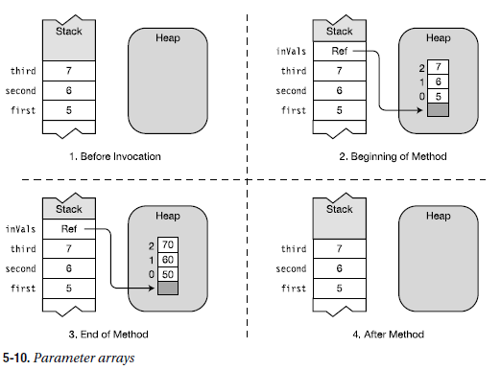

Slide 27
Recursion
Besides calling other methods, a method can also call itself. This is called recursion.
Recursion can produce some very elegant code, such as the following method for computing the factorial of a number. Notice that inside the method, the method calls itself, with an actual parameter of one less than its input parameter.
int Factorial(int inValue)
{
if (inValue <= 1)
return inValue;
else
return inValue * Factorial(inValue - 1); // Call Factorial again.
} ↑
Calls itself

Slide 28
class Program
{
public void Count(int inVal)
{
if (inVal == 0)
return;
Count(inVal - 1); // Invoke this method again.
↑
Calls itself
Console.WriteLine("{0} ", inVal);
}
static void Main()
{
Program pr = new Program();
pr.Count(3);
}
}
The output of the program
1
2
3

Slide 29
Method Overloading
A class can have more than one method with the same name. This is called method overloading.
Each method with the same name must have a different signature than the others.
• The signature of a method consists of the following information from the method
header of the method declaration:
– The name of the method
– The number of parameters
– The data types and order of the parameters
– The parameter modifiers
• The return type is not part of the signature—although it is a common mistake to believe that it is.
• The names of the formal parameters are also not part of the signature.
Not part of signature
↓
long AddValues( int a, out int b) { ... }
↑
Signature

Slide 30
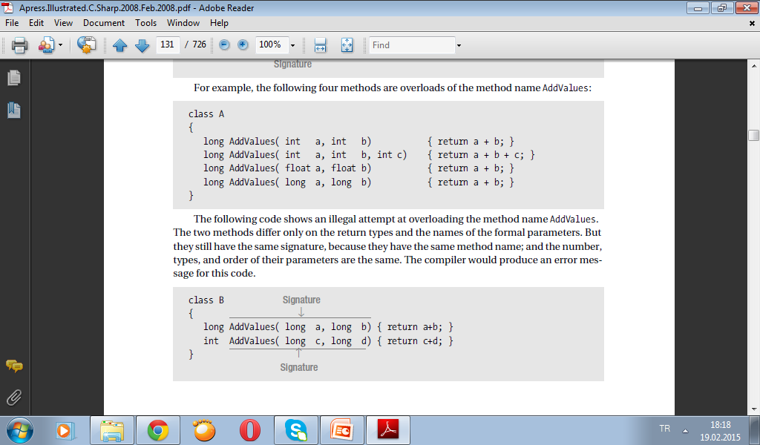
class A
{
long AddValues( int a, int b) { return a + b; }
long AddValues( int a, int b, int c) { return a + b + c; }
long AddValues( float a, float b) { return a + b; }
long AddValues( long a, long b) { return a + b; }
}

